Slide 1
Hello Everybody ! 👋
Notes:
Good morning everyone. Today, I am going to talk to you about Python. It is powerful, it is dangerous, and it can swallow its prey whole.

Slide 2
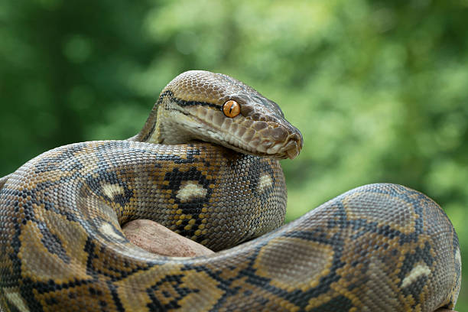
Notes:
Wait, sorry, wrong slides

Slide 3
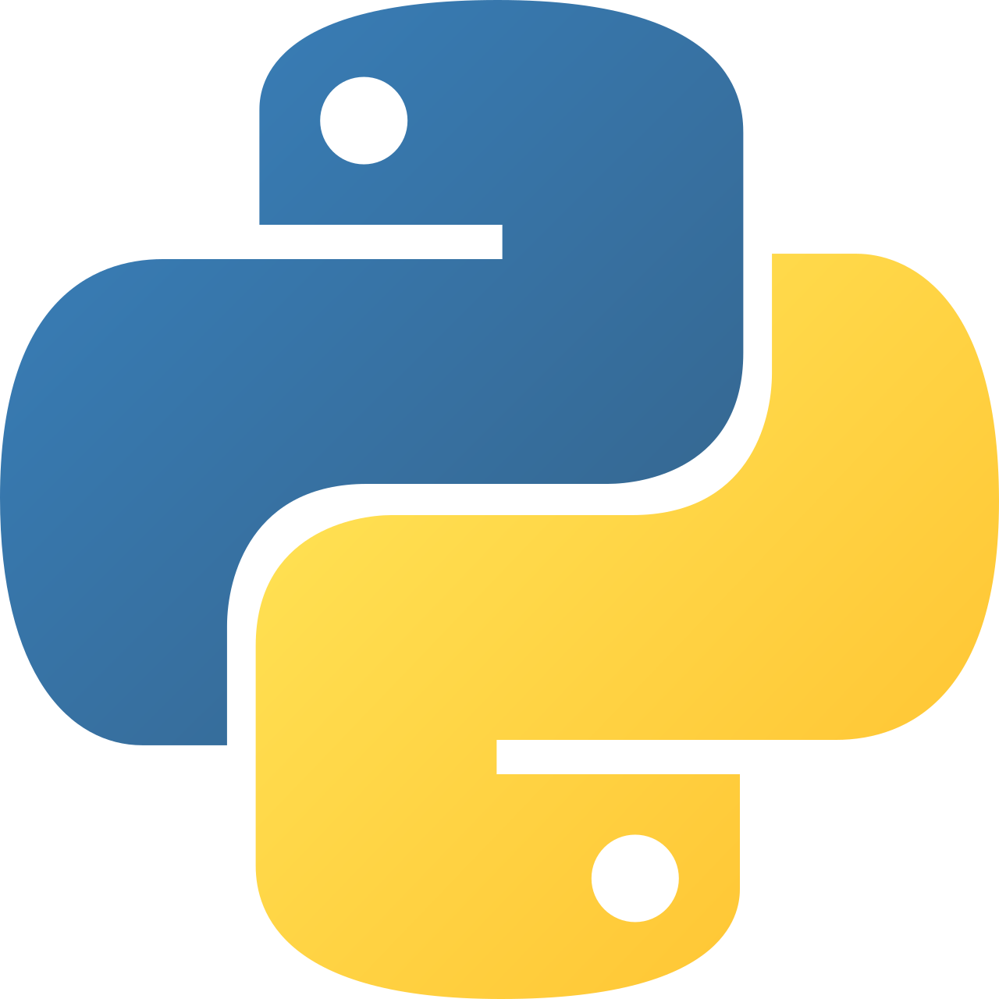
Python
The programming language
Notes:
I meant Python, the programming language

Slide 4
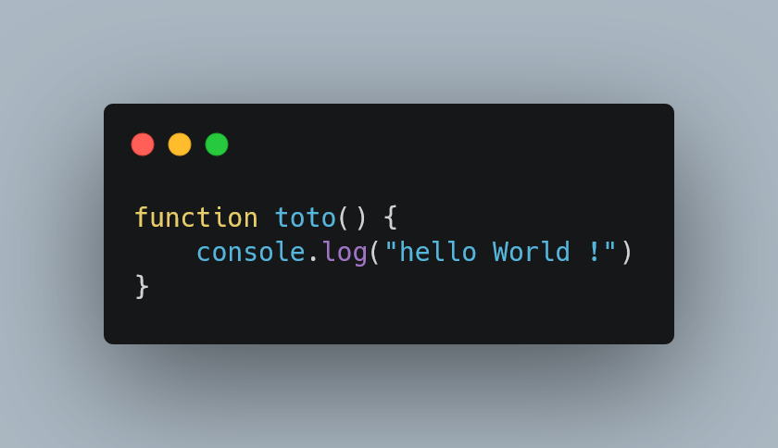
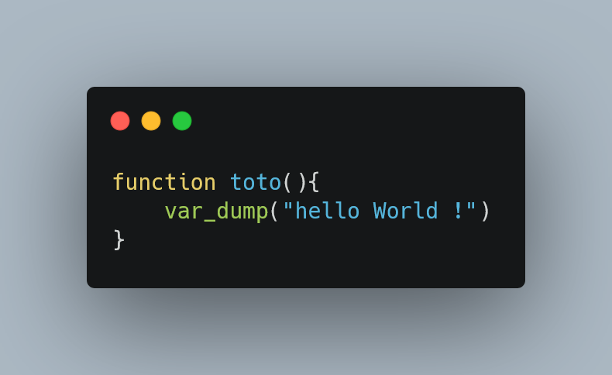
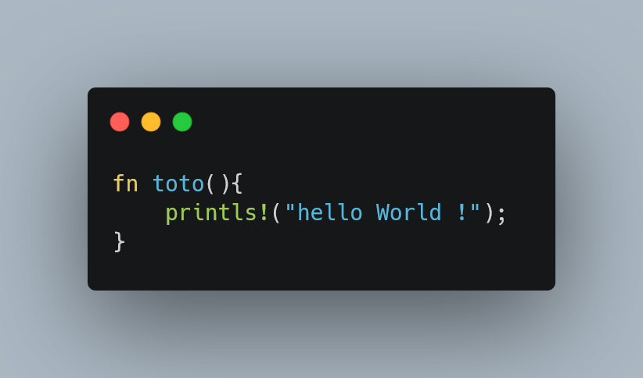
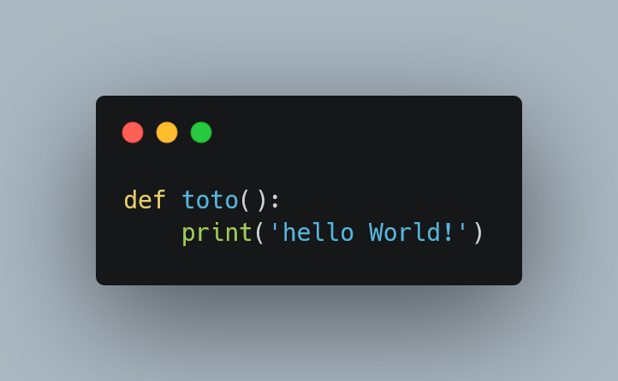
Javascript
PHP
Rust
Python :
Notes:
Look, in JS, we use “function” for create a function, that is logic. In PHP to, we use the function world. You can find other variations, like in Rust, which takes the 'f' from the beginning and the 'n' from the end of the word 'function’ And in Python, we have … def. What does it mean? Are we 'defining' something? No, it's just Python being lazy. It forces you to guess.

Slide 5
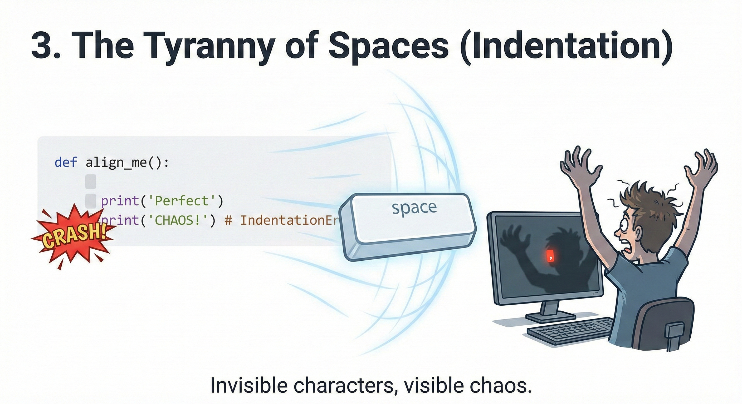
Indentation
All languages use curly brackets { }
Python uses... invisible spaces.
Notes:
In normal languages, you use curly brackets { } to group your code. You can visually see where things start and end. Python decided that was too easy. Instead, Python uses... invisible spaces.
If you accidentally press the spacebar one too many times, your entire application crashes. It is the only programming language in the world where you need a physical ruler on your screen to make sure your code works.

Slide 6
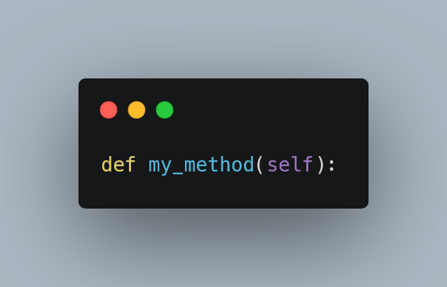
The self keyword
Python is incredibly narcissistic :
Notes:
And don't get me started on Object-Oriented Programming. Python is incredibly narcissistic. In a class, every single method needs to have the word self written in it. Literally: def my_method(self):. We get it, Python, it's all about you. You don't need to remind us every single line.

Slide 7
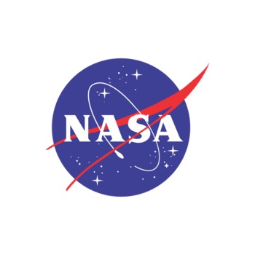
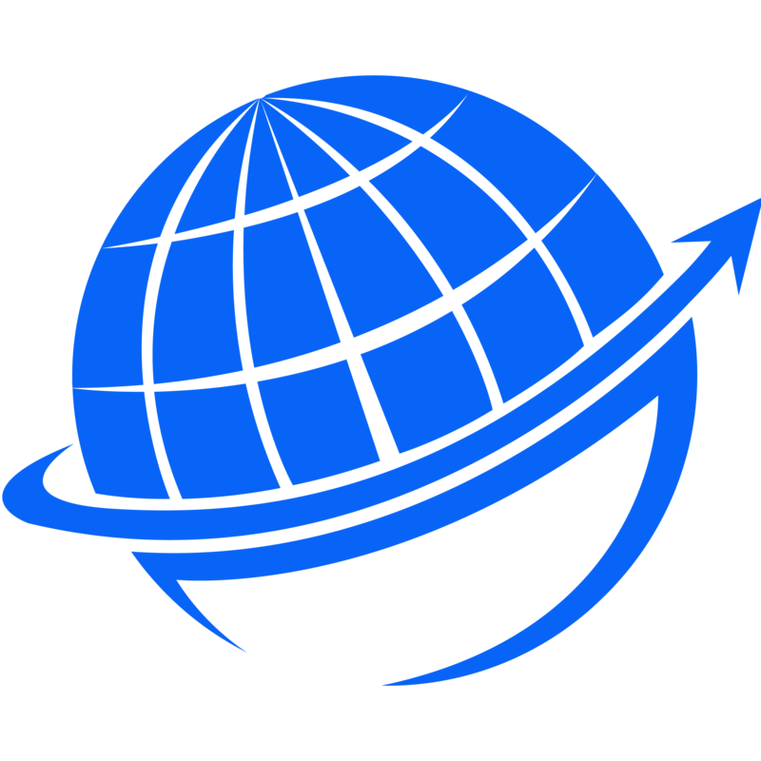
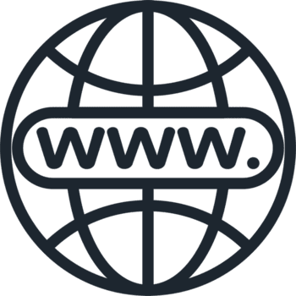
Conclusion
Use by Nasa
Runs the modern
Internet
Most popular language in the World
Notes:
To conclude, Python is a language where you use invisible spaces, write incomplete words, and constantly talk about 'self'. And yet... it runs the modern internet, NASA uses it, and it's the most popular language in the world. Which probably proves that programmers are completely crazy, for sure. Thank you.

Slide 8
Notes:
Tanks to listen me

